Slide 1
Where the creeks run dry or ten feet high: Streamflow prediction in Australian context
Rajitha Athukorala
Sally Cripps
Willem Vervoort
Australasian Applied Statistics Conference – AASC 2022

Slide 2
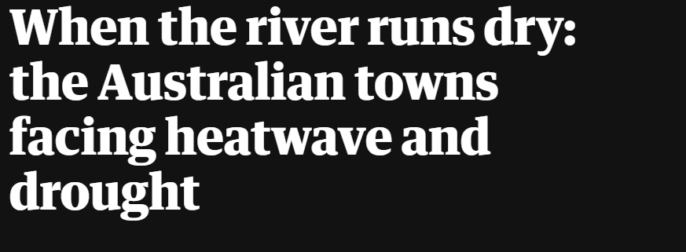
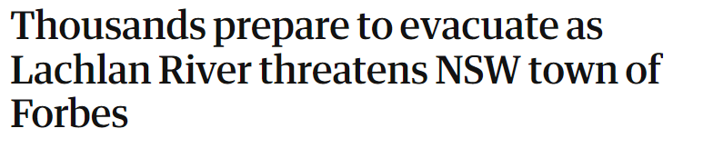
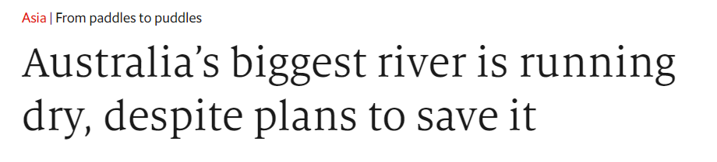
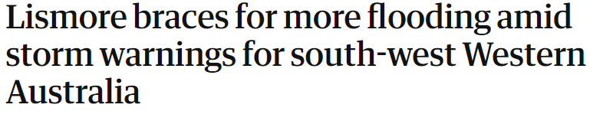

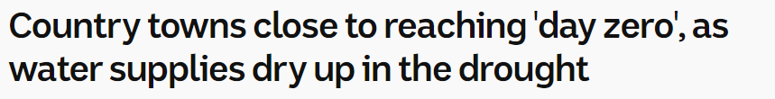
A tale of two ‘extremes’

Slide 3
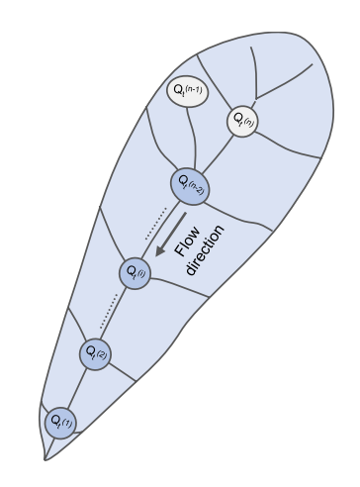
Towards a fully Bayesian statistical approach to streamflow forecasting in space and time
Data driven
Probabilistic → Quantify uncertainty
Adapt to varying climate conditions
Forecasting in both space and time
Reference: A Bayesian Hierarchical Network Model for Daily Streamflow Ensemble Forecasting
(Á. Ossandón, B. Rajagopalan, U. Lall, J. S. Nanditha and V. Mishra, Water Resources Research 2021 Vol. 57 Issue 9)

Slide 4
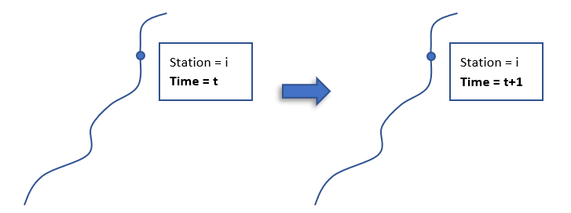
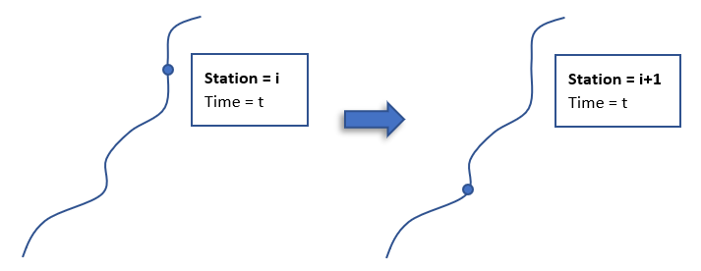
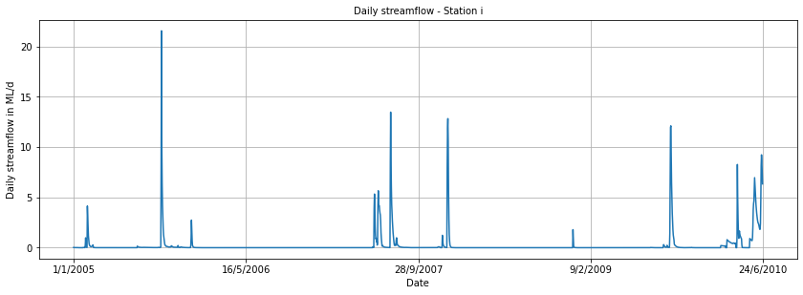
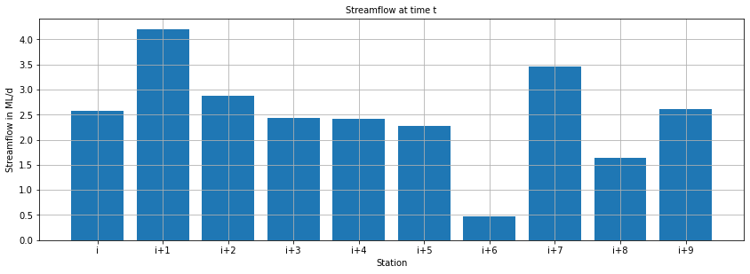
Forecasting in space and time
Notes:
The temporal component: where we try to predict at different times and the spatial component: where we try to predict in different locations along the river.

Slide 5
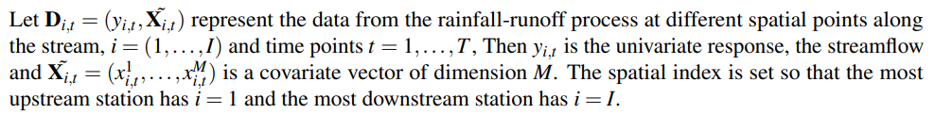
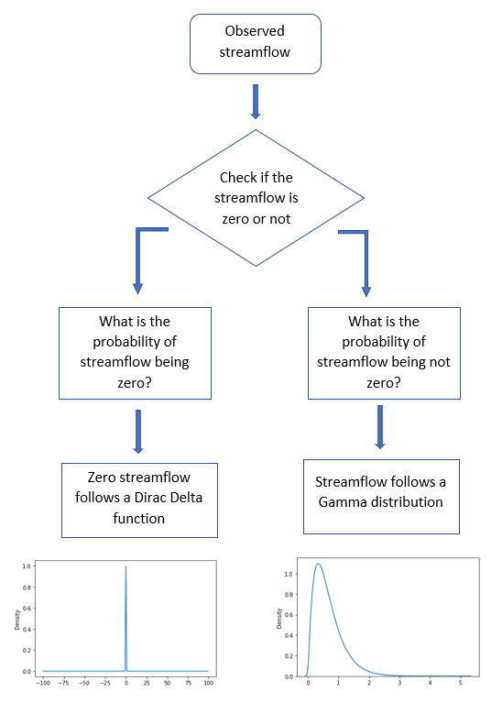
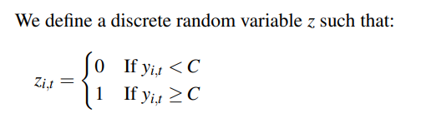
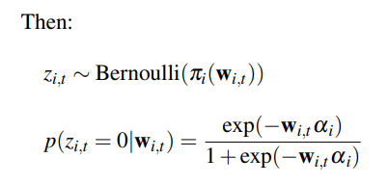
The model setup

Slide 6
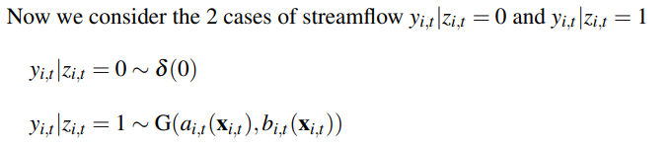
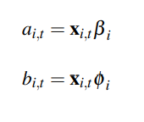
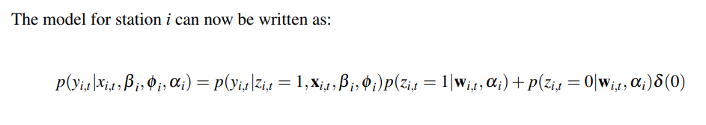
The model setup

Slide 7
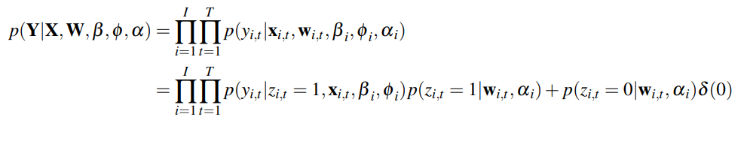
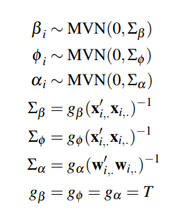
Likelihood and priors

Slide 8
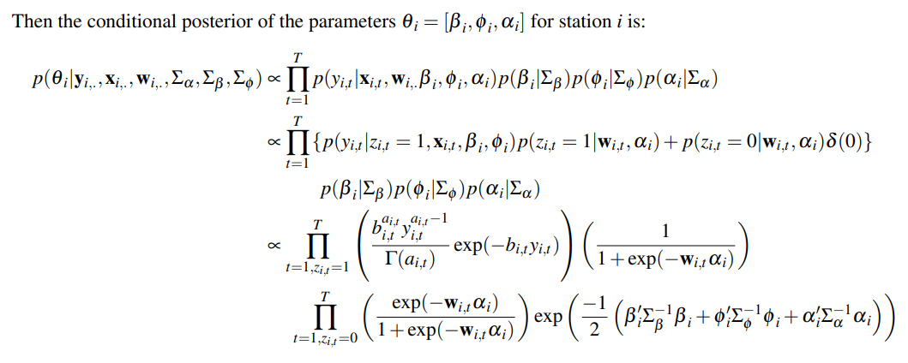
Inference

Slide 9
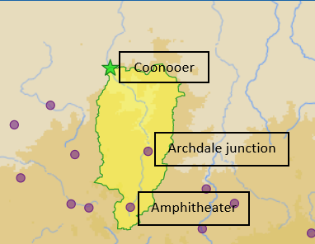
Applying the methodology to an Australian dataset
Selected river:
Avoca river (Victoria)
Selected stations/id:
Coonooer (408200)
Archdale junction (408206)
Amphitheater (408202)

Slide 10
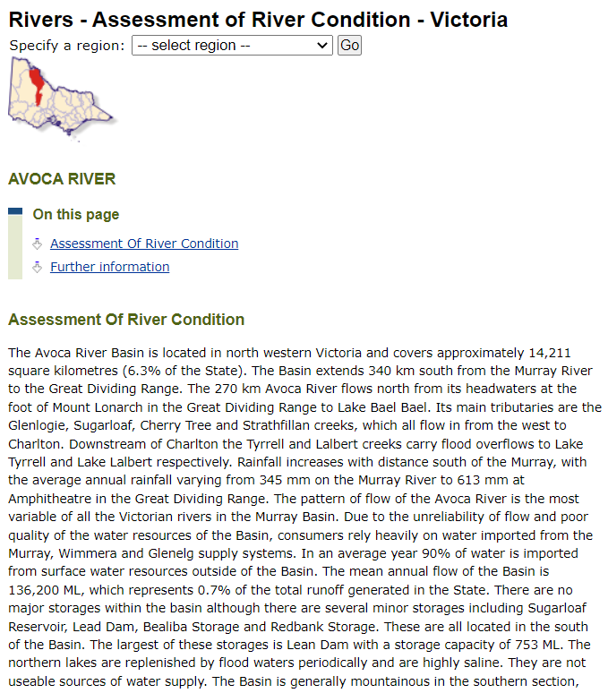
Applying the methodology to an Australian dataset

Slide 11
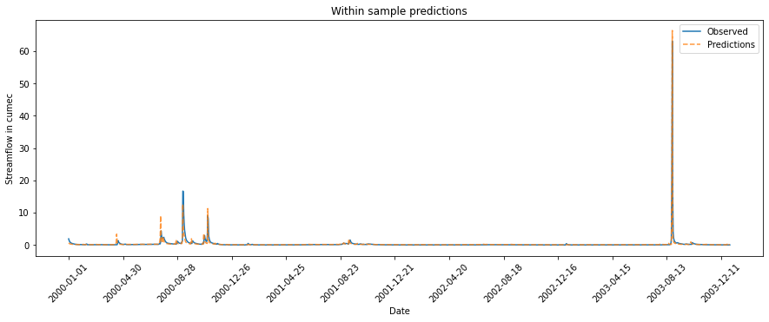
Results

Slide 12
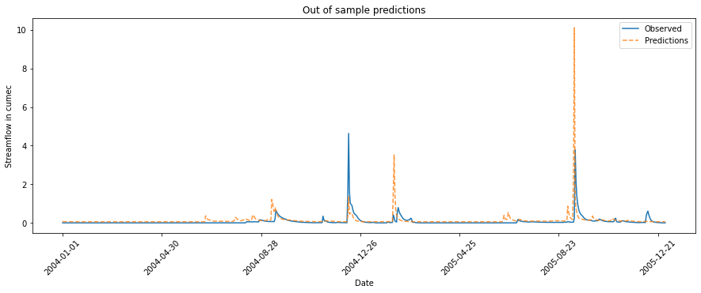
Results

Slide 13
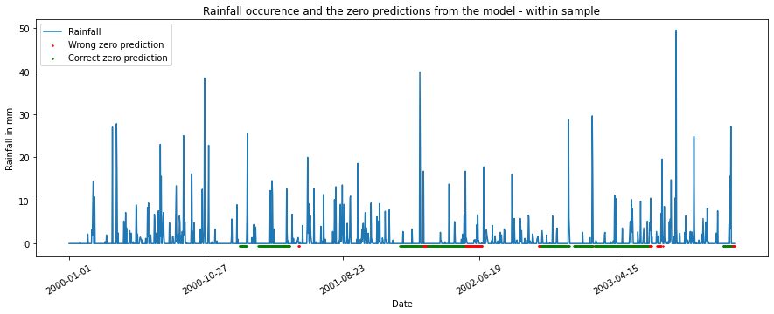
Results
451 | 95
43 | 871

Slide 14
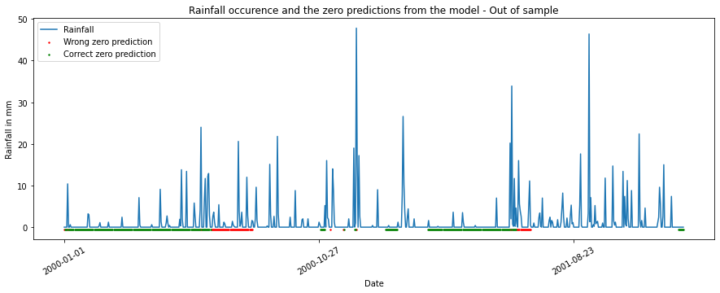
Results
304 | 74
79 | 273

Slide 15
Way forward
Efficient sampling
Best set of covariates
Adding more mixtures to the non-zero flows

Slide 16
References
Post-processing rainfall forecasts from numerical weather prediction models for short-term streamflow forecasting [https://hess.copernicus.org/articles/17/3587/2013/]
SWIFT2: High performance software for short-medium term ensemble streamflow forecasting research and operations [http://www.bom.gov.au/water/7daystreamflow/media/publications/SWIFT2_high_performance_software_Perraud_et_al.pdf]
Improvement of a parsimonious model for streamflow simulation [https://doi.org/10.1016/S0022-1694(03)00225-7]
Error reduction and representation in stages (ERRIS) in hydrological modelling for ensemble streamflow forecasting [https://hess.copernicus.org/articles/20/3561/2016/]

Slide 17


Contact
The University of Sydney
Room 230, Biomedicial Building C81,
1 Central Ave, South Eveligh NSW 2015
rajitha.athukorala@sydney.edu.au

